Slide 1
Generic Programming in C++

Slide 2
Generic Programming
Generic programming is
About generalizing software components so that they can be easily reused in a wide variety of situations
In C++
Class and function templates are particularly effective mechanisms for generic programming because they make the generalization possible without sacrificing efficiency

Slide 3
Generic Programming
A template is a simple and yet very powerful tool in C++.
The simple idea is to pass data type as a parameter so that we don’t need to write the same code for different data types.
For example
A software may need sort() for different data types
Rather than writing and maintaining the multiple codes, we can write one sort() and pass data type as a parameter
C++ adds two new keywords
To support templates: ‘template’ and ‘typename’.
The second keyword can always be replaced by keyword ‘class’

Slide 4
Generic Programming
How do templates work? Templates are expanded at compile time like macros
The difference is
The compiler does type checking before template expansion
The idea is simple
Source code contains only function/class
But compiled code may contain multiple copies of same function/class

Slide 5
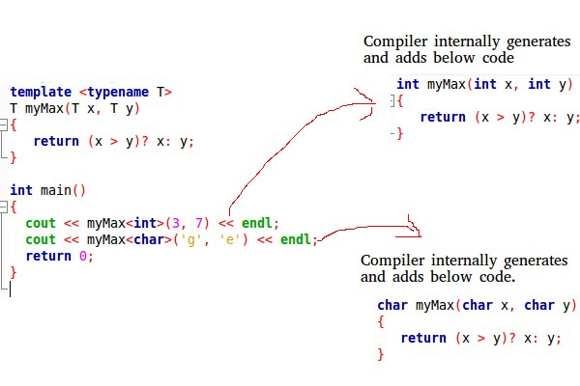
Generic Programming
.

Slide 6
Generic Programming
Function Templates
We write a generic function that can be used for different data types
Examples of function templates are sort(), find_max(), find_min() etc.

Slide 7
Generic Programming
#include <iostream>
using namespace std;
// One function works for all data types. This would work even for user defined types if operator '>' is //overloaded
template <typename T>
T find_Max(T x, T y)
{
return (x > y)? x: y;
}
int main()
{
cout << find_Max(<int>(3, 7) << endl; // Call myMax for int
cout << find_Max <double>(3.0, 7.0) << endl; // call myMax for double
cout << find_Max <char>('g', 'e') << endl; // call myMax for char
return 0;
}

Slide 8
Generic Programming
Class Templates
Like function templates, class templates are useful when a class defines something that is independent of the data type
Can be useful for classes like LinkedList, BinaryTree, Stack, Queue, Array, etc.

Slide 9
Generic Programming
#include <iostream>
using namespace std;
template <typename T>
class Array {
private:
T *ptr;
int size;
public:
Array(T arr[], int s);
void print();
};
template <typename T>
Array<T>::Array(T arr[], int s) {
ptr = new T[s];
size = s;
for(int i = 0; i < size; i++)
ptr[i] = arr[i];
}
template <typename T>
void Array<T>::print() {
for (int i = 0; i < size; i++)
cout<<" "<<*(ptr + i);
cout<<endl;
}
int main() {
int arr[5] = {1, 2, 3, 4, 5};
Array<int> a(arr, 5);
a.print();
return 0;
}

Slide 10
Generic Programming
Can there be more than one arguments to templates?
Yes, like normal parameters, we can pass more than one data types as arguments to templates

Slide 11
Generic Programming
#include<iostream>
using namespace std;
template<class T, class U>
class A
{
T x;
U y;
public:
A()
{
cout<<"Constructor Called"<<endl;
}
};
int main()
{
A<char, char> a;
A<int, double> b;
return 0;
}

Slide 12
Generic Programming
Like normal parameters, we can specify default arguments to templates
#include<iostream>
using namespace std;
template<class T, class U = char>
class A
{
public:
T x;
U y;
A() { cout<<"Constructor Called"<<endl; }
};
int main()
{
A<char> a; // This will call A<char, char>
return 0;
}

